Slide 1

ERC20 Custom Token Tutorial

Slide 2
Who Am I? Data Scientist – Wannabe Research Scientist mailto: amitprusty@u.nus.edu
LinkedIn
Twiiter

Slide 3
What are tokens?
Say you want to issue share of stocks to the many cofounders (different percentages) for your new startup company that is yet to be registered.
In the Ethereum world, you can represent the shares in the form of “tokens” that can be sold, sold back to the company, transferred, etc.
You can create a “token contract” and deploy it in Ethereum blockchain.
Then the tokens can be transferred, sold, etc.

Slide 4
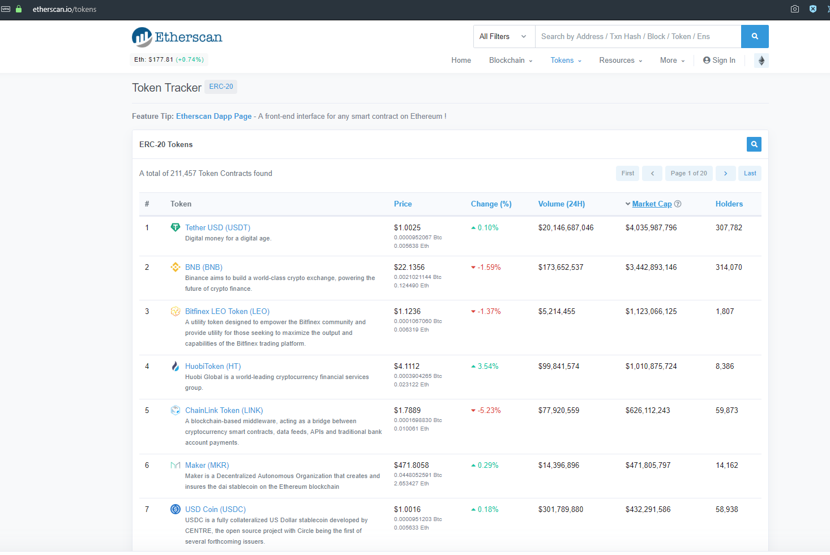
Popular Ethereum Tokens

Slide 5
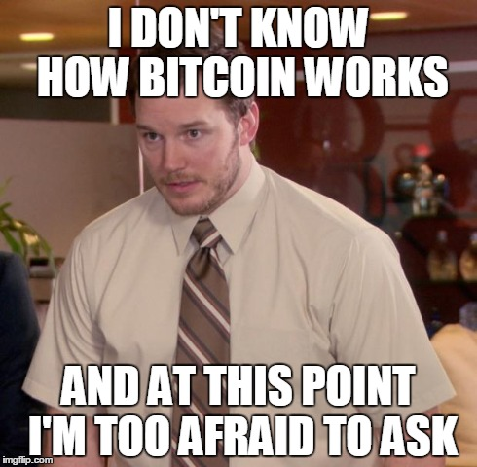

Slide 6
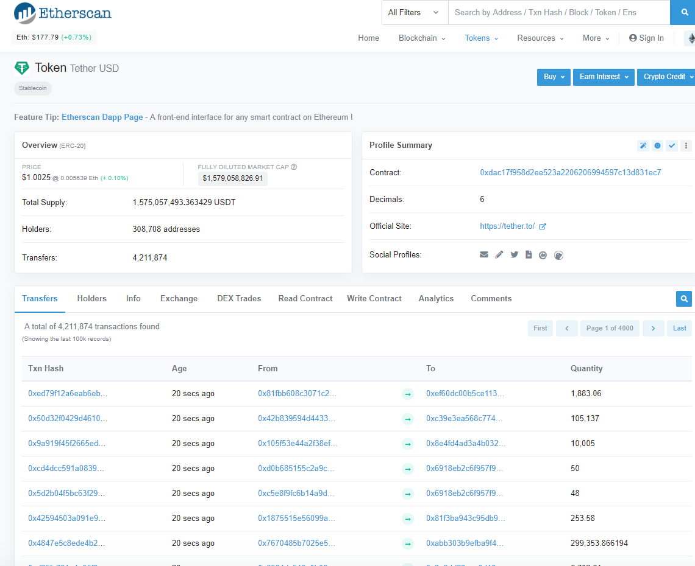
Let’s Examine Tether USD Token
Notice this contract address and decimal properties.
Notice total supply property below.

Slide 7
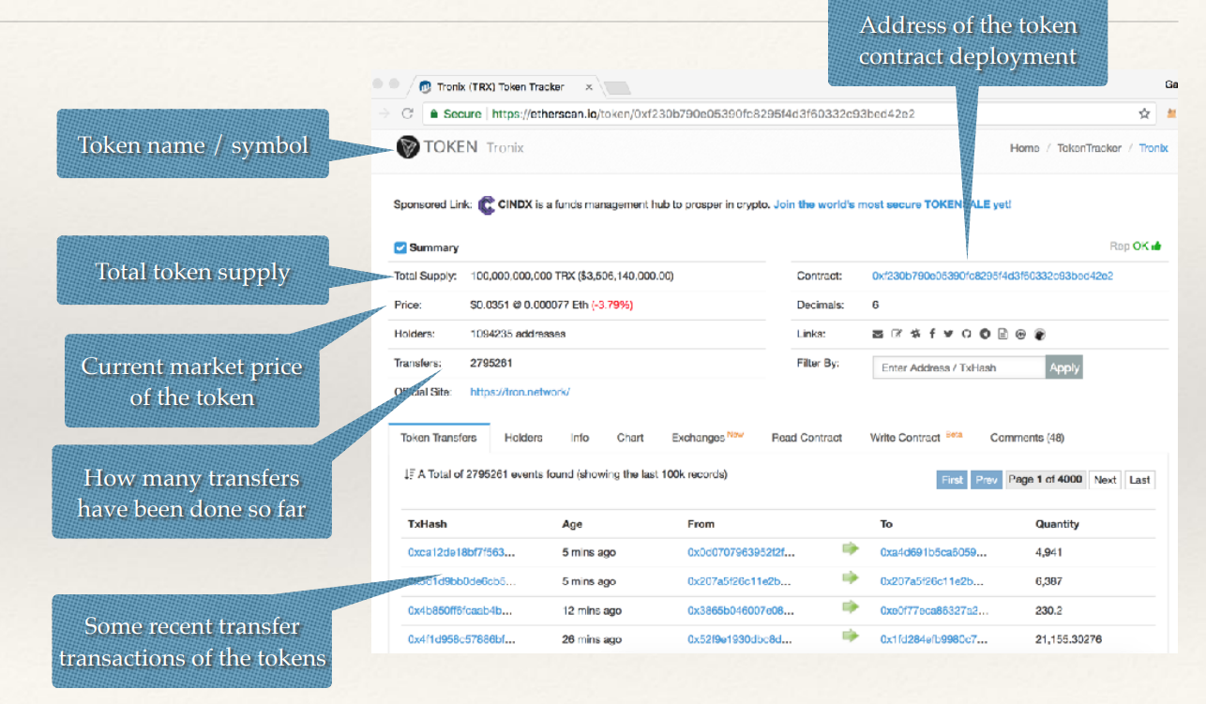
Observe a few details.

Slide 8
What are ERC20 Tokens
ERC20 is a “token standard” for creating Ethereum token contracts.
ERC stands for Ethereum Request for Comments.
Any token contract that adheres to the specification follows ERC20.
Can use with any wallets that understand ERC20.
Most ICOs (Initial Coin Offerings) have adhered to ERC20

Slide 9

Let’s create our own Token and offer it.

Slide 10


Slide 11
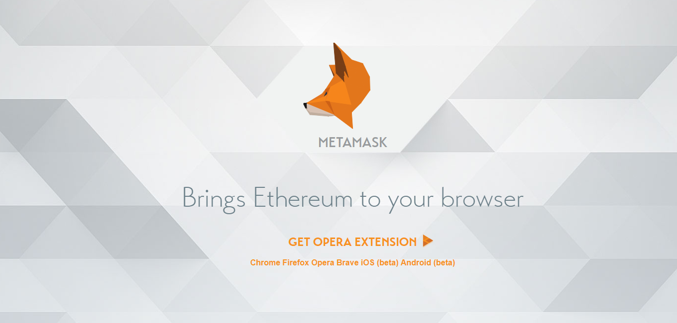
Go to: https://metamask.io
Download and install the chrome extension in your browser.
After installing the extension, it will prompt you to create an account by creating new passwords. Follow the steps in your screen.
Notes:
https://metamask.io

Slide 12
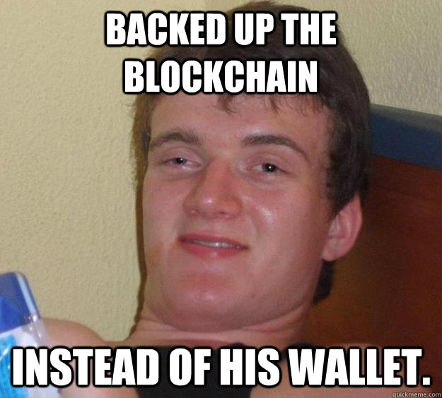

Slide 13
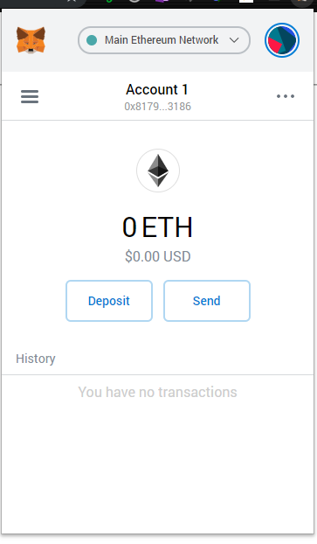
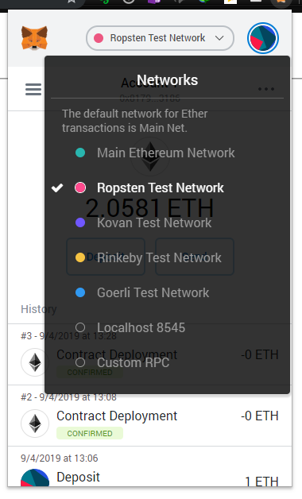
Change your network to Ropsten Test network so that no one loses money.

Slide 14
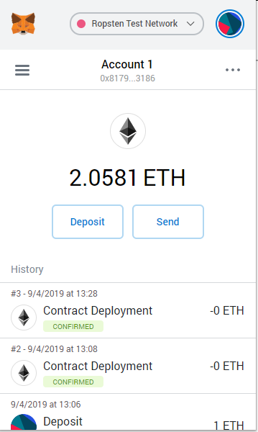
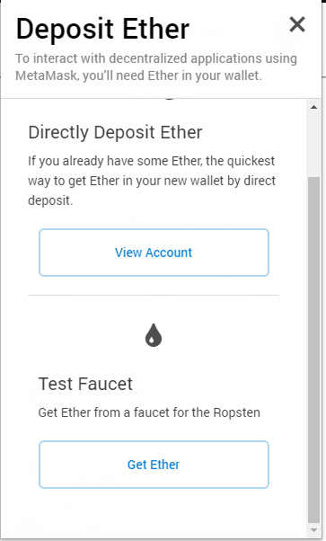
Click on Deposit and Select Get Ether

Slide 15
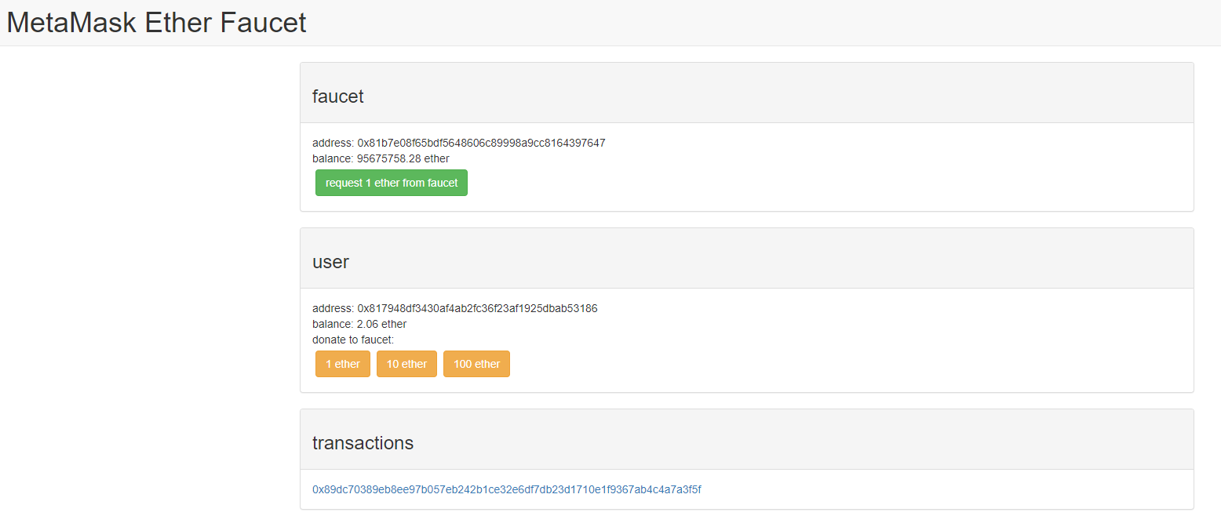
Click on request 1 ether from faucet.
Then click on the transaction below once it appears.
Notes:
https://faucet.metamask.io

Slide 16
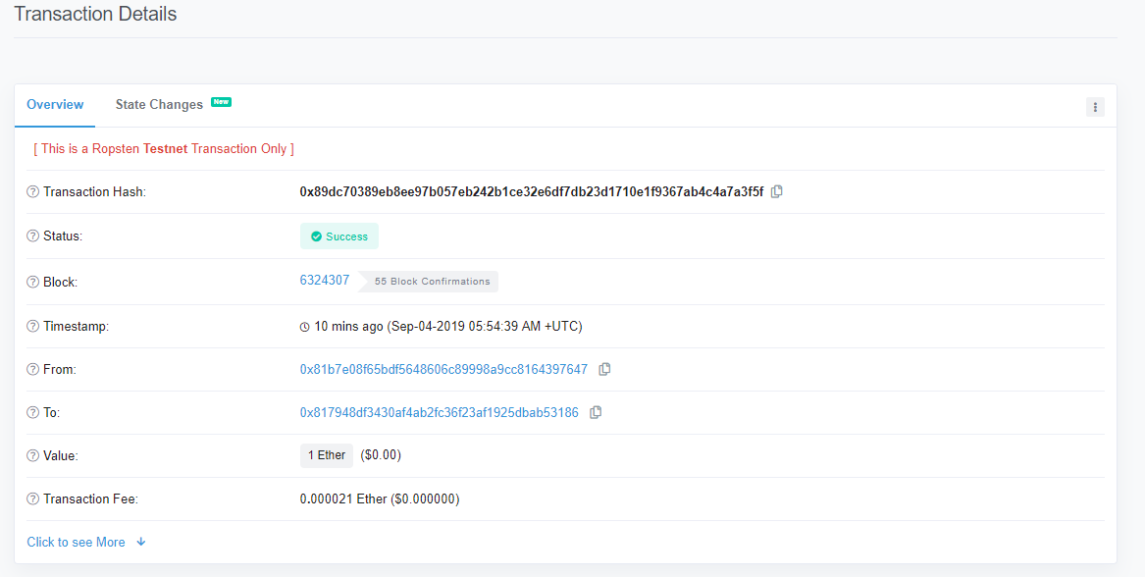
Wait for Transaction to be Success.

Slide 17
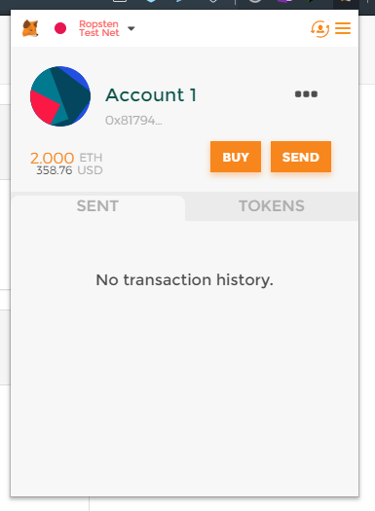
Check your Wallet. Now you will have some ethers based how many you requested.

Slide 18
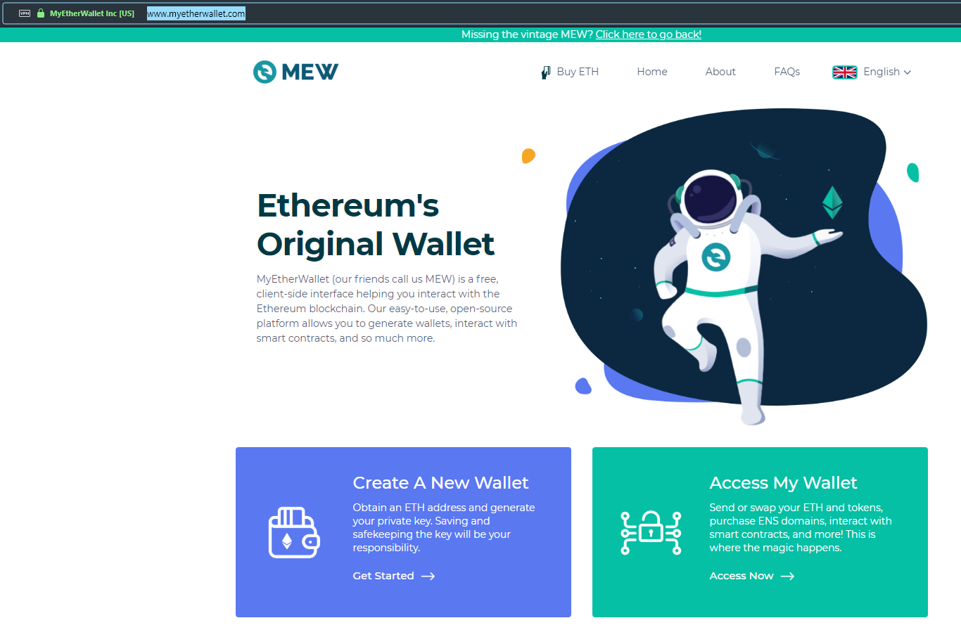
Go to: https://www.myetherwallet.com
Click on access my wallet.
Notes:
https://www.myetherwallet.com

Slide 19
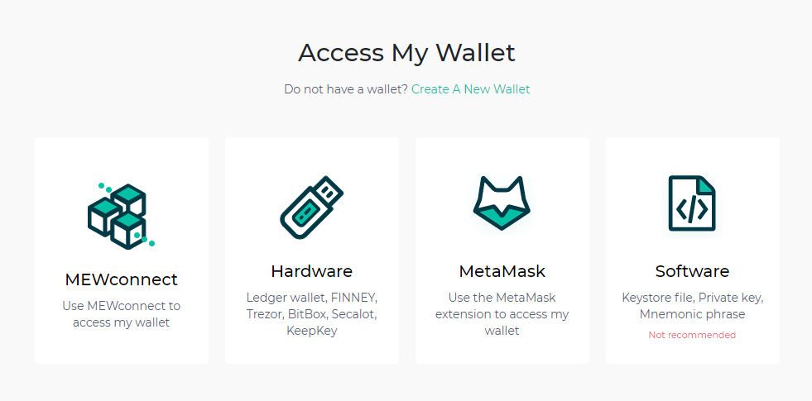
To access your wallet, click on METAMASK

Slide 20
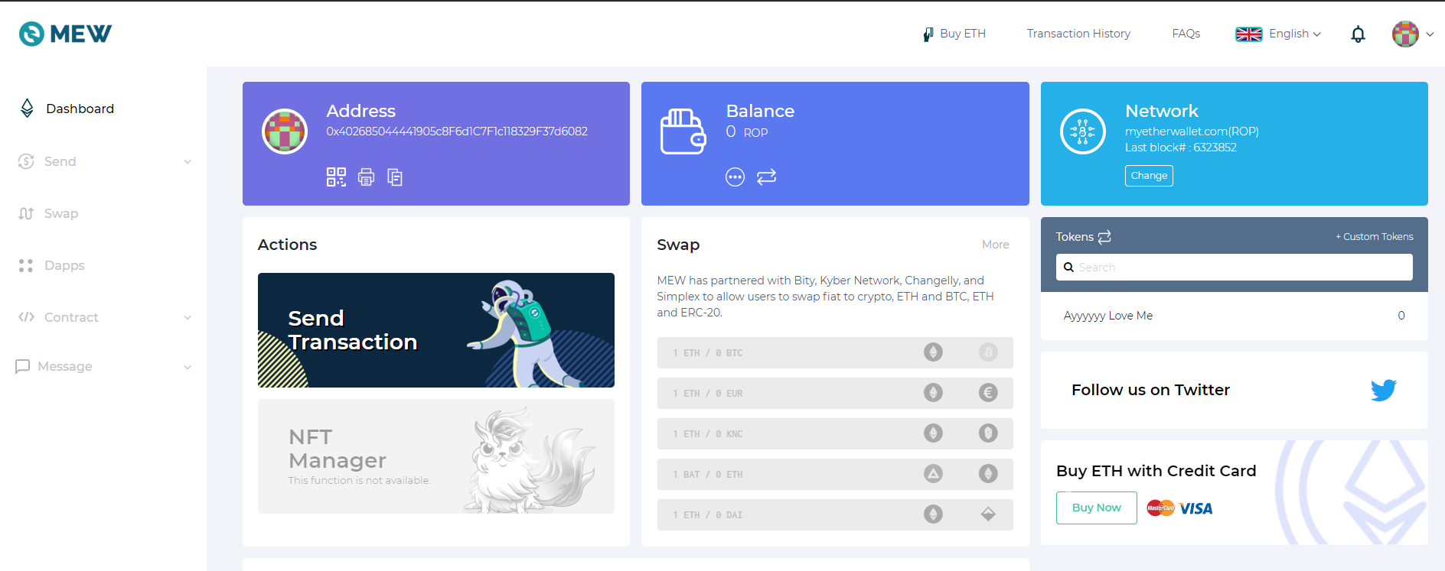

Slide 21
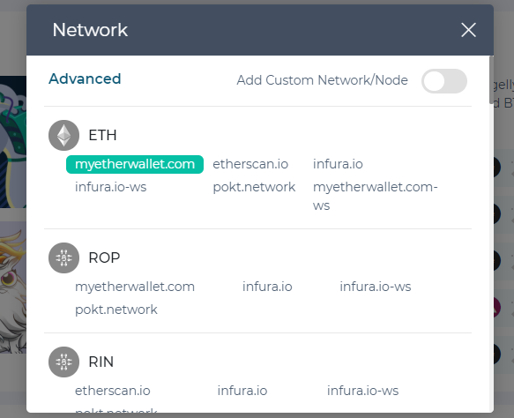
Change your network to Ropsten Test network so that no one loses any money in your MEW wallet.

Slide 22
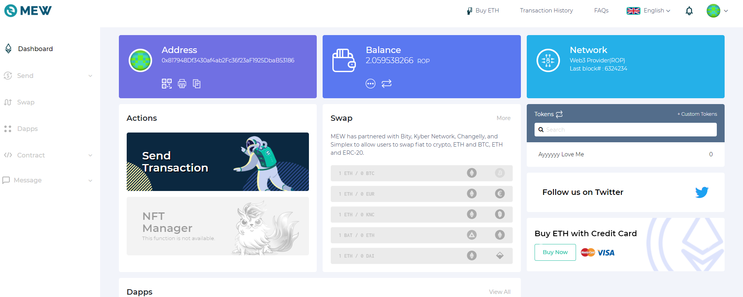

Slide 23
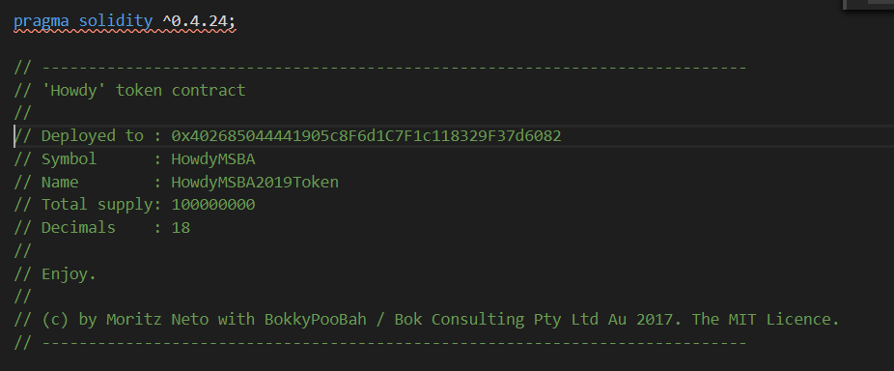
Now let’s get started:
Open the contract you downloaded in your Text Editor.
Go to Line 3–15 and look at the comment section.
Change Line 4 to the title of your Smart Contract
Change Line 6 to the Ropsten Ethereum address you created in MetaMask
Change Line 7’s Symbol to your respective coin name (Keep it short)
Change Line 8 to the name of your token
Notice we have chosen solidity 0.4.24. This will come handy later.

Slide 24
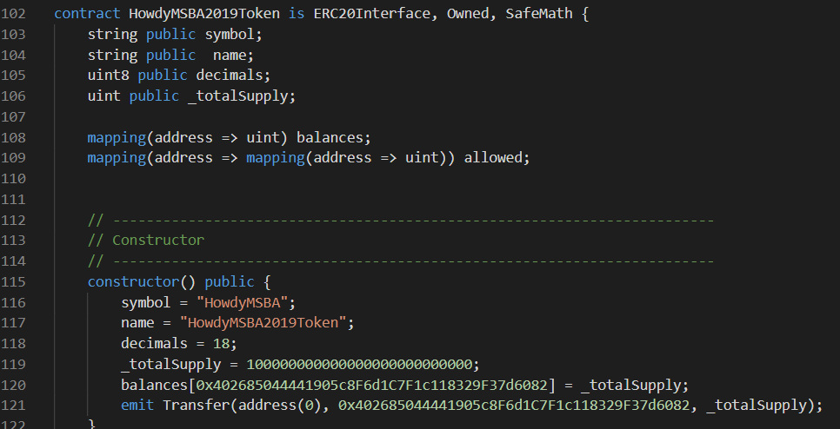
Go to Line 102 and change HowdyMSBA2019Token to your token name. Go to Line 117 and again change the name.
Go to Line 116 and change the symbol HowdyMSBA to your Symbol.
In Line 120 change the address to your MetaMask wallet address. Same for Line 121.
Decimals and total supply on Line 118 and 119 leave it as it is. Standard (max) is 18 decimals, means a coin can split in 18 parts. If you want to issue 100 tokens, on the total supply part you must put 100 followed by the no. of decimals that you choose.
Ex: If I want to emit 100 tokens, what I will put on total supply is: 100000000000000000000.

Slide 25
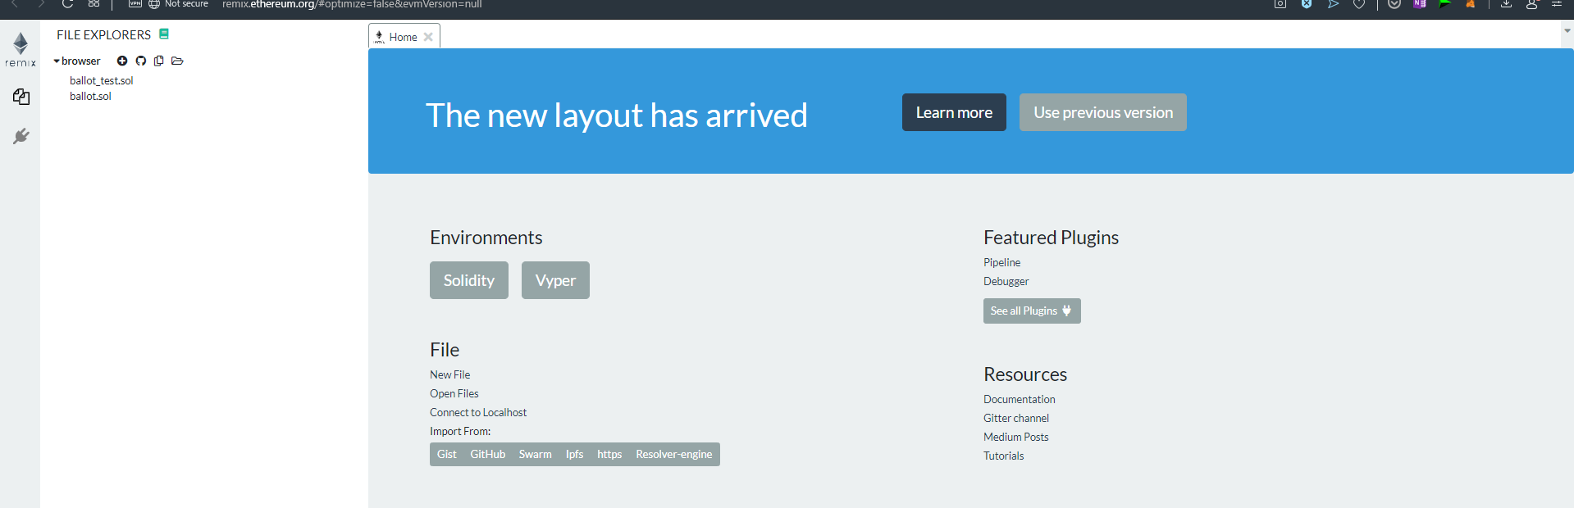
Go to: http://remix.ethereum.org/#optimize=false&evmVersion=null
Click on Use Previous Version.
Notes:
http://remix.ethereum.org/#optimize=false&evmVersion=null

Slide 26
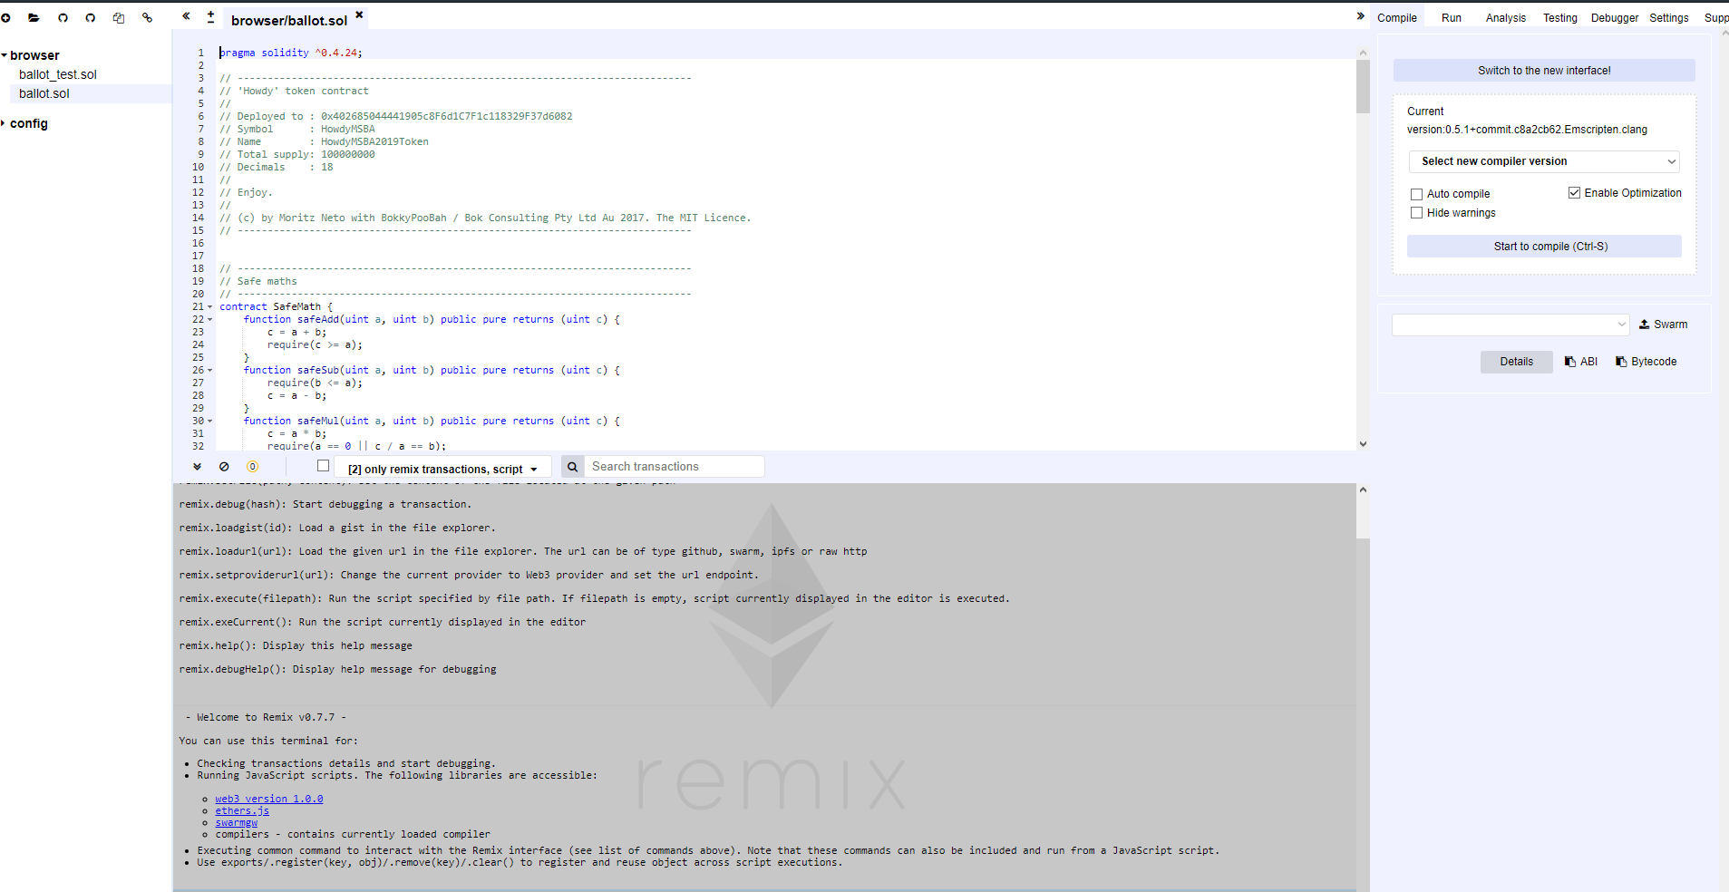
In the browser/ballot.sol, paste the code you just edited!. Select compiler version 0.4.24, else it will throw error. Before compiling select enable optimization.
If something red comes up, there is something wrong in the code. If there is yellow warning, it’s alright.
Now Under Compile →Details →Choose the Token you are creating.

Slide 27
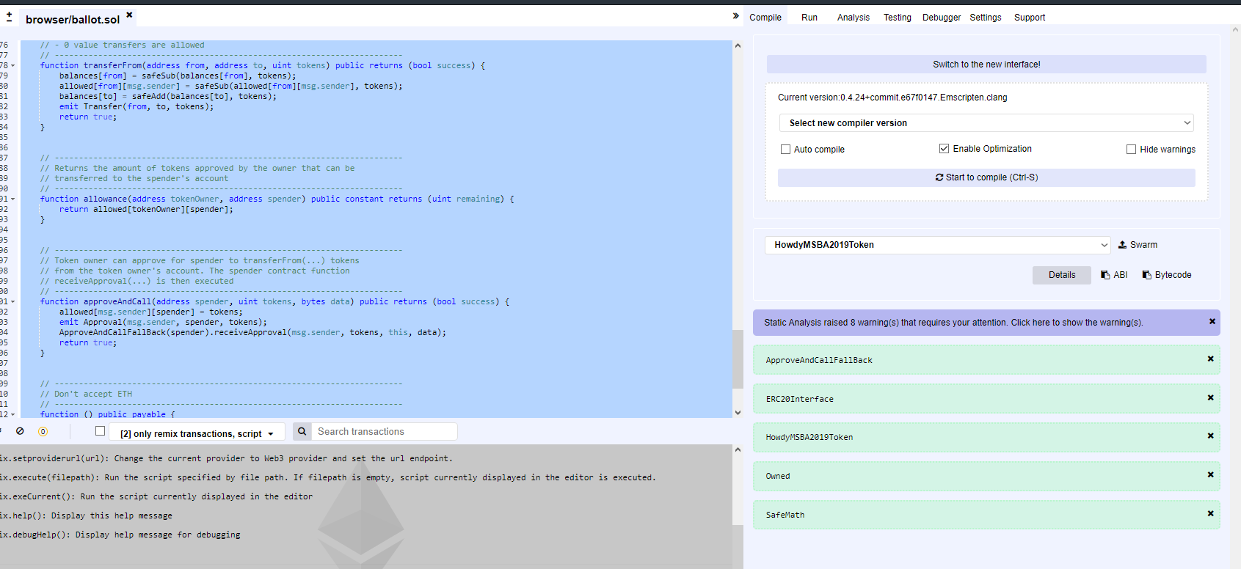
If compiled successfully you will see a screen like this. In the box you can see three buttons. Select Your token name in the drop-down menu.
Remember the other two buttons, ABI and Bytecode. We will come back to this. Do not close this window.

Slide 28
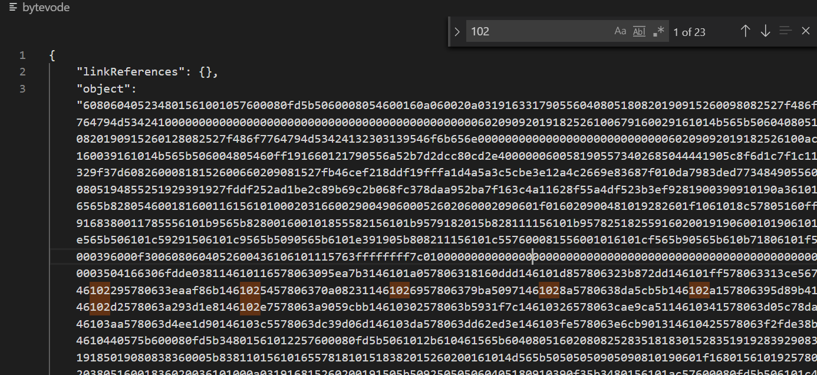
Under ByteCode press the 📋button to copy the ByteCode to your clipboard.
Paste the bytecode into the text editor and select all the strings next to “object”:

Slide 29
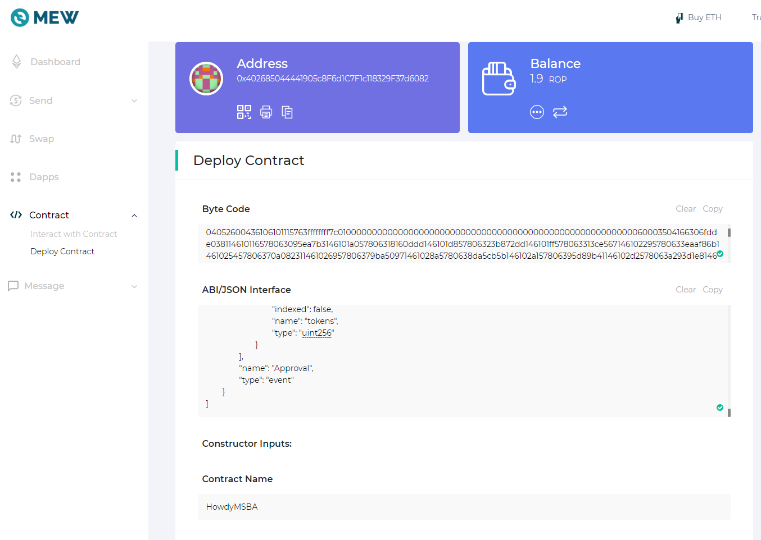
Go to MEW wallet , hopefully you are still signed in. If not sign in with MetaMask.
On the left side, click on contract and then deploy contract. Once it opens paste the Bytecode you copied next to object.
Go to the start of the bytecode and write 0x. Now you will see a green tick mark.
Then go to remix window and copy the ABI and paste into ABI box. That’s it. Now you are ready to sign and deploy contract.

Slide 30
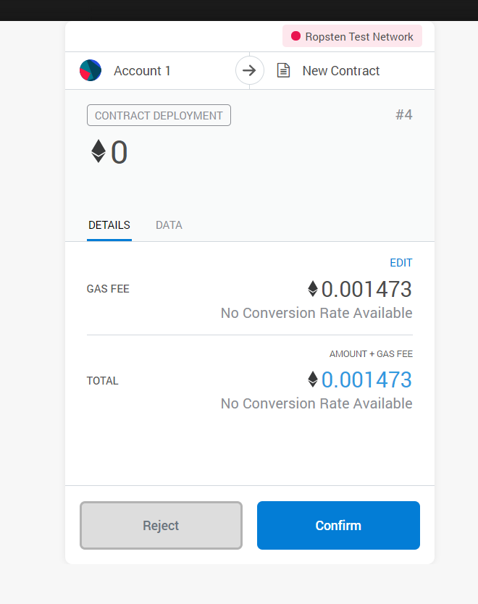
Accept the transaction.

Slide 31
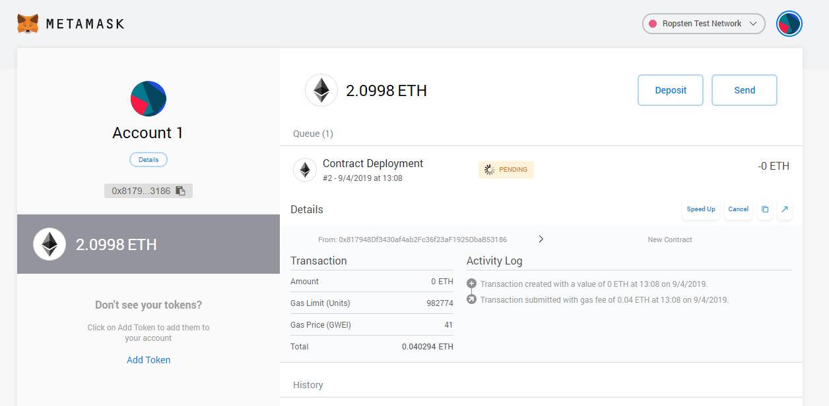
Once you click deploy, you can check the transaction in your METAMASK account. Click on the transaction in the activity log.

Slide 32
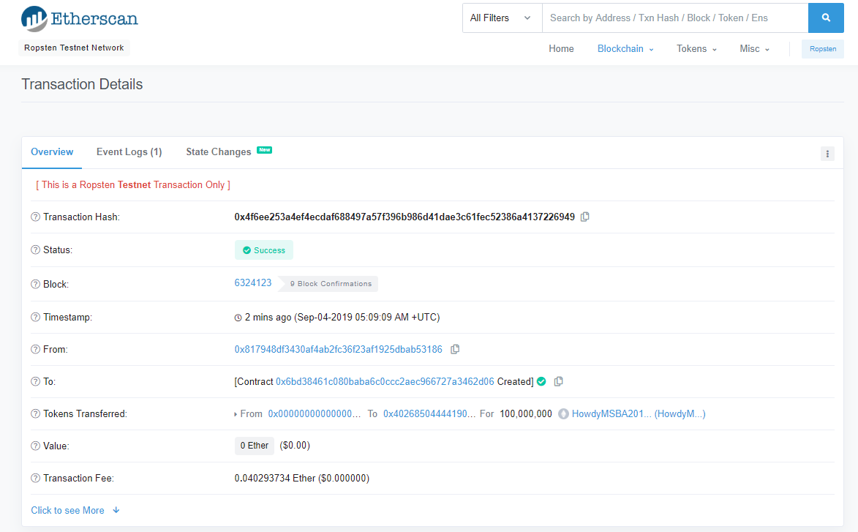
Wait for the success status then click on contract in the To field.
Click on To Contract

Slide 33
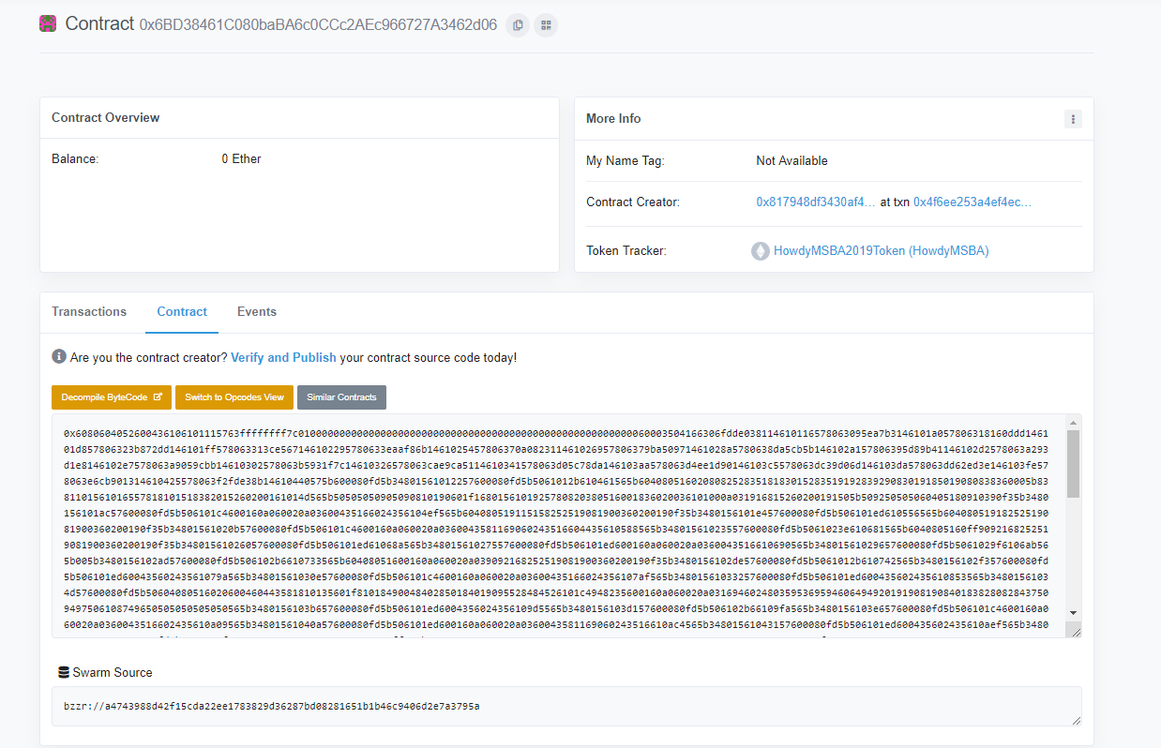
Now we are going to register this contract. For that click on Verify and Publish.

Slide 34
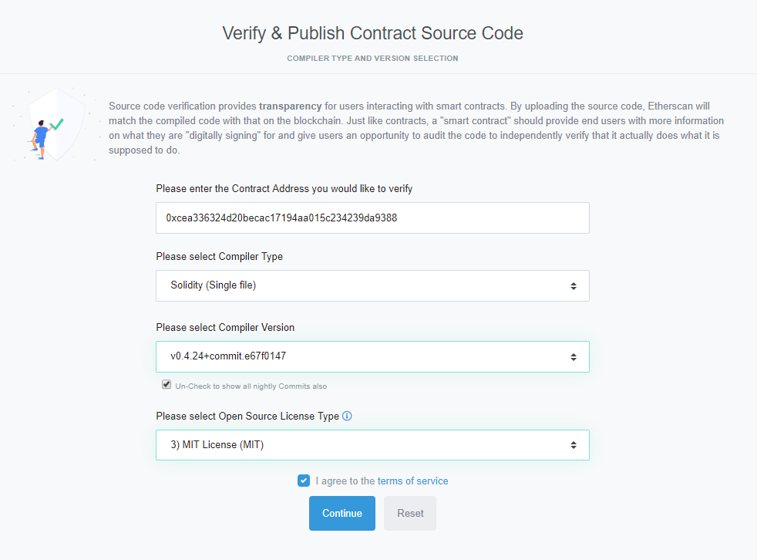
After you click verify and publish this window will open. Select the options as below:

Slide 35
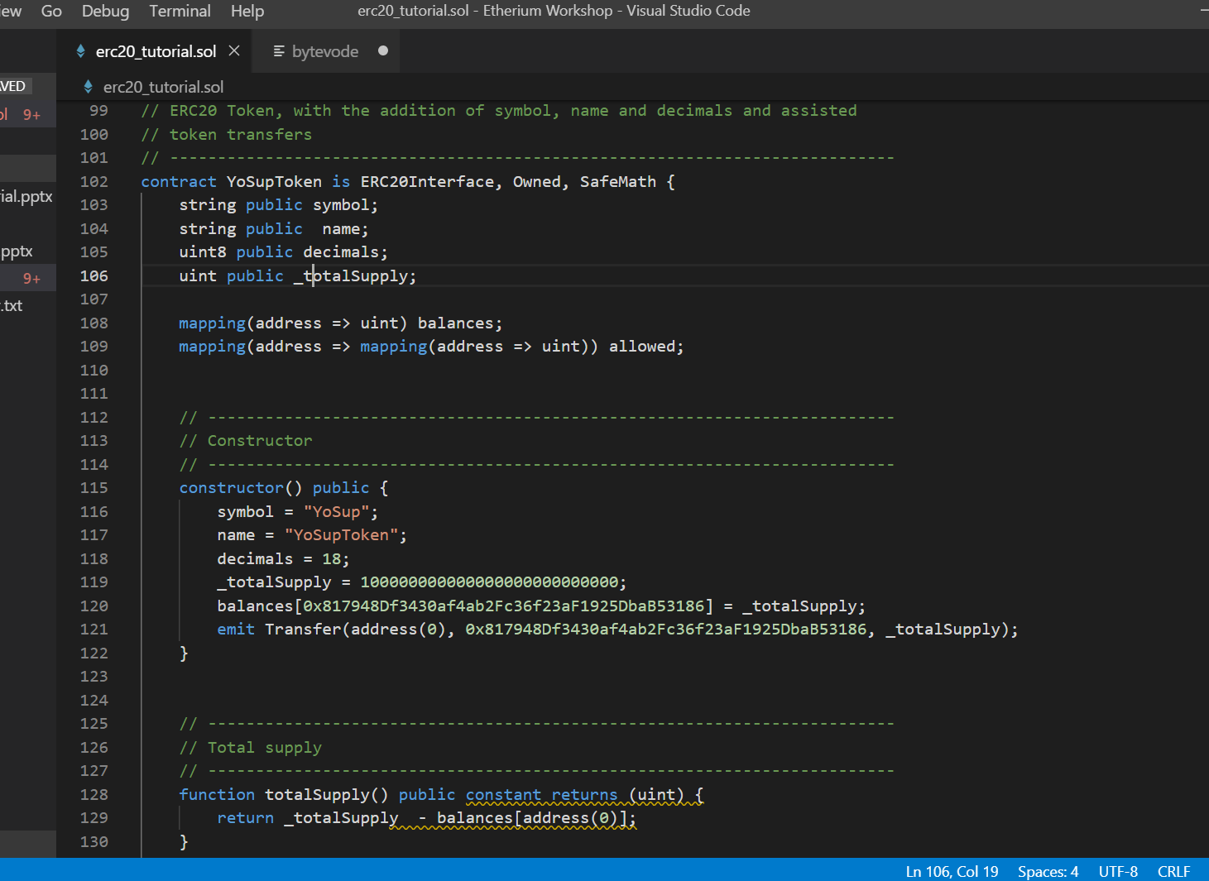
Copy the codes from erc20_tutorial file.

Slide 36
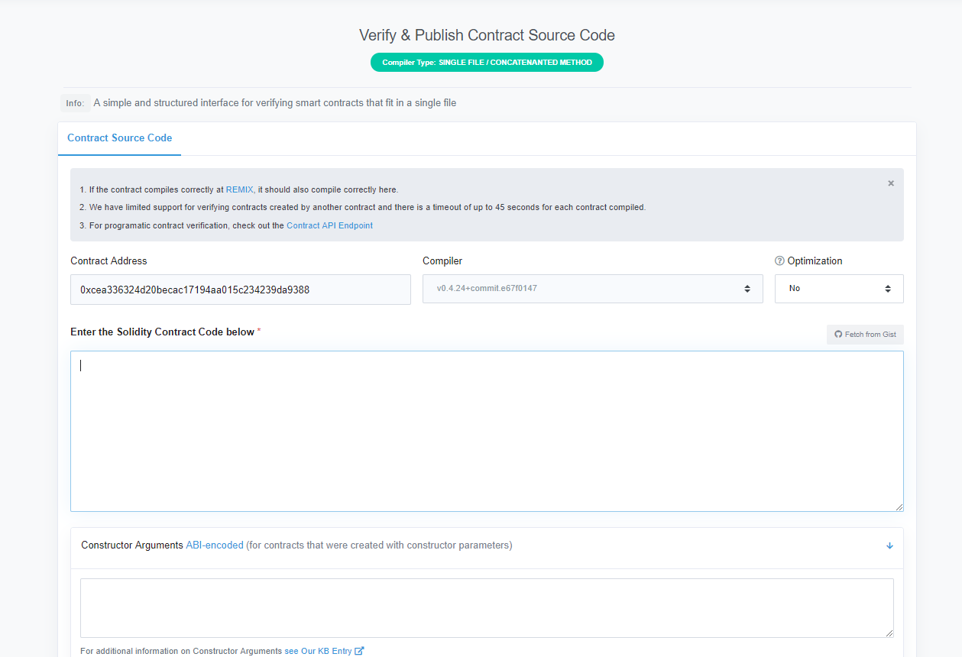
Paste the Copied codes in the code box below.
Click on verify and publish.
Remember to enable optimization. Else you will get error.

Slide 37
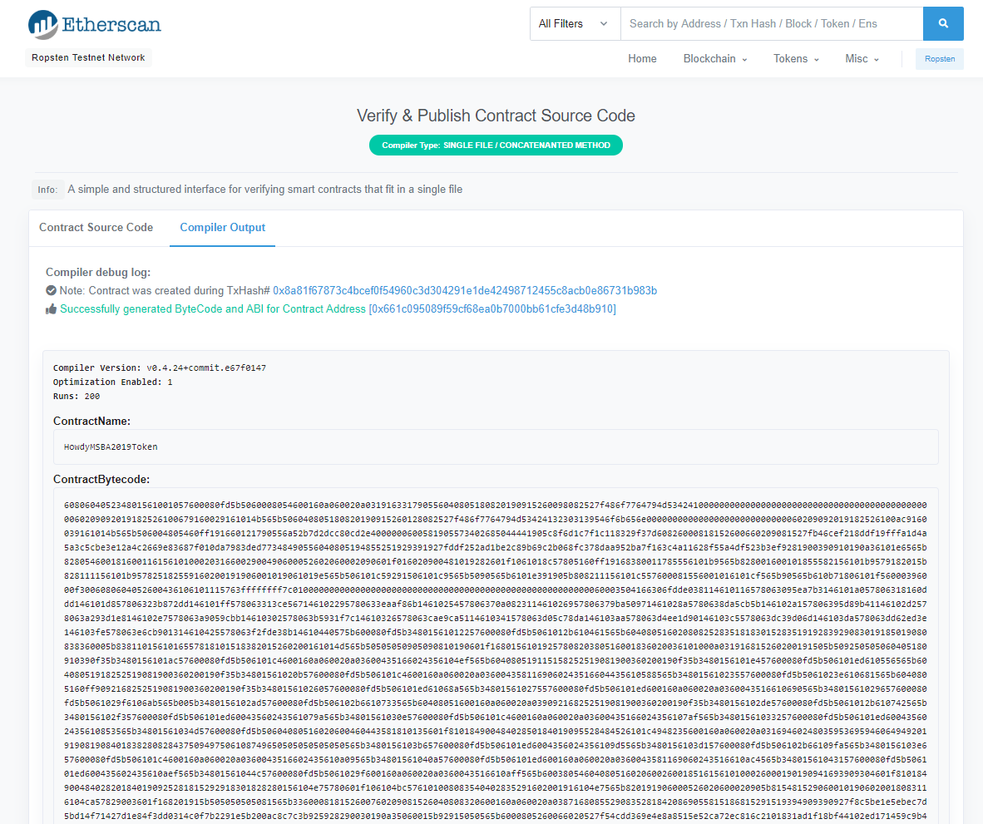
If verified successfully you will see the below screen.

Slide 38
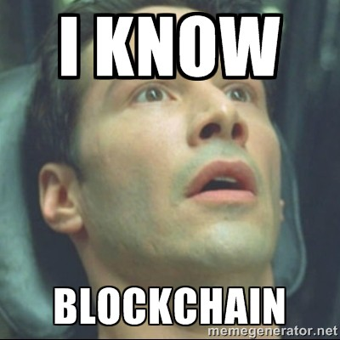

Slide 39
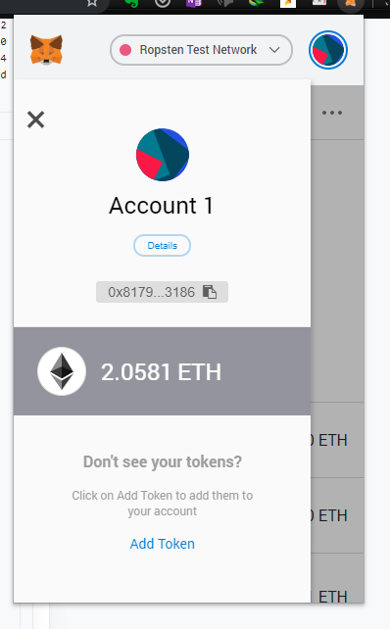
Now go to your METAMASK account and click on add token.

Slide 40
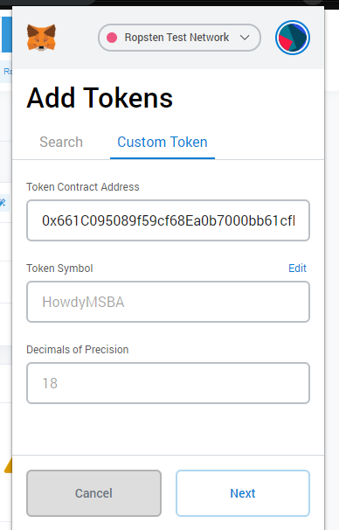
Paste the token address into the address box and all other details will appear automatically.

Slide 41
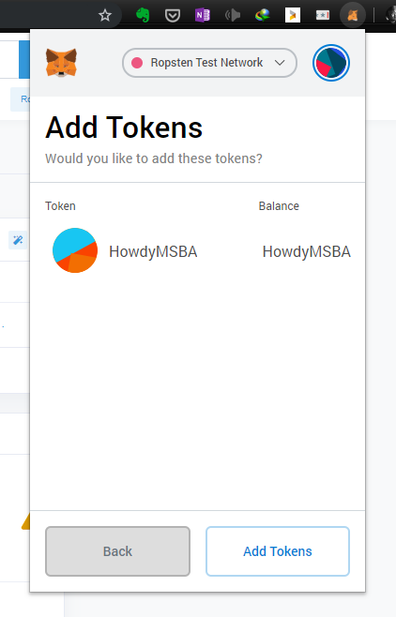
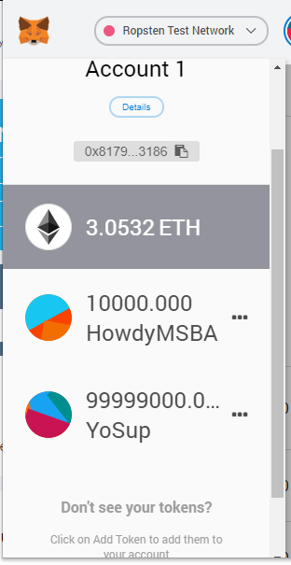
Now you can send your tokens to any account you want. For example I sent 1000 tokens to my other Ethereum wallet from YoSup Contract here and received 10000 of HowdyMSBA Tokens into this wallet.

Slide 42
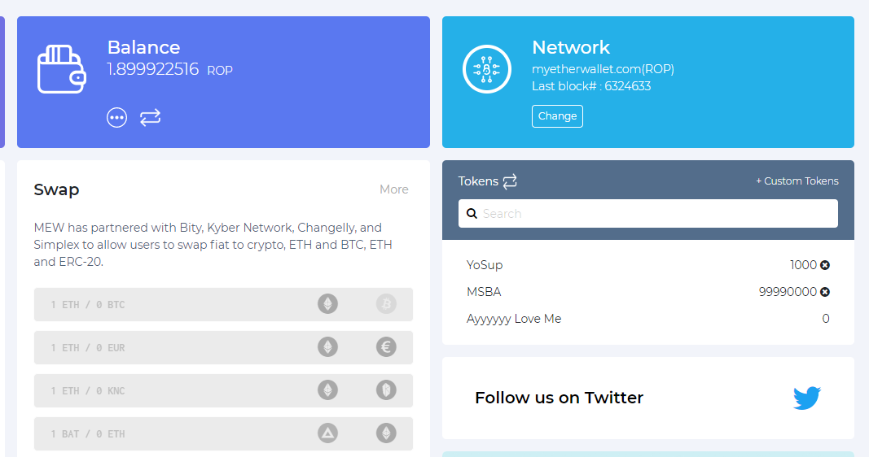
You can see now my other account has 1000 YoSup tokens.
Congratulations now you have your own BitCoin.

Slide 43
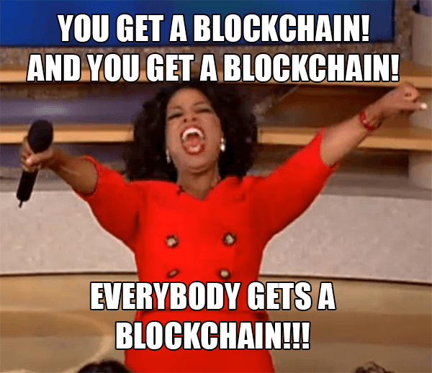

Slide 44
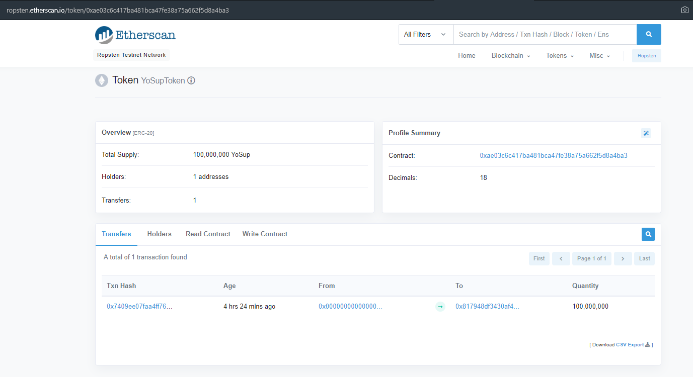

Slide 45
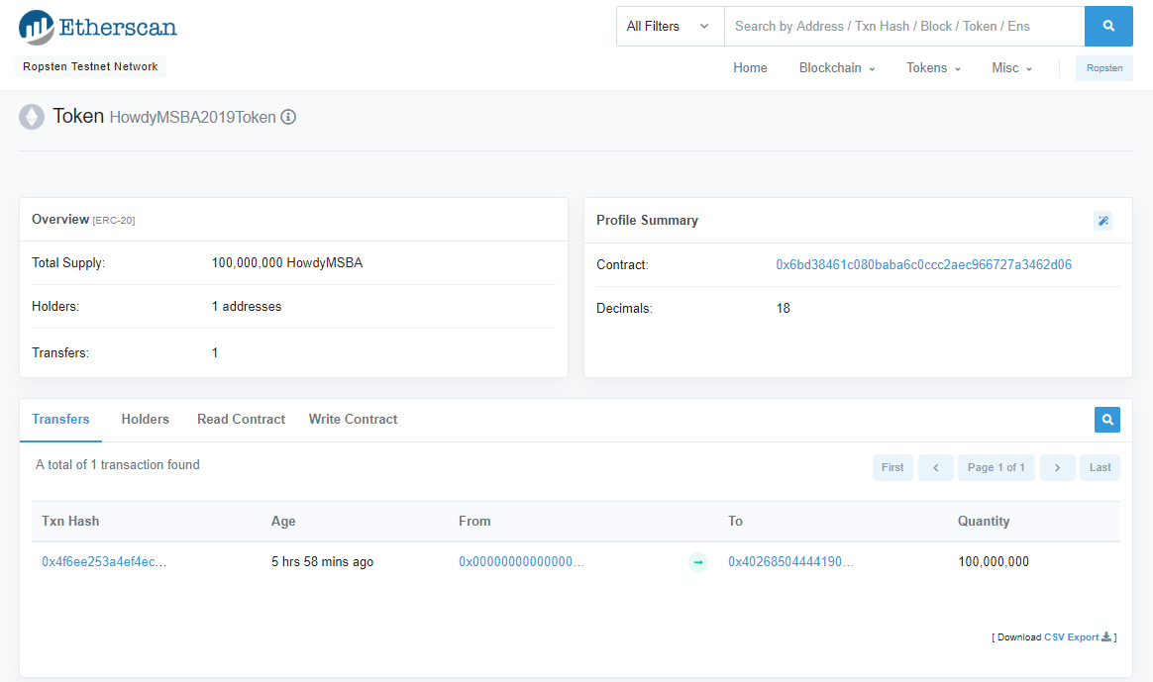

Slide 46
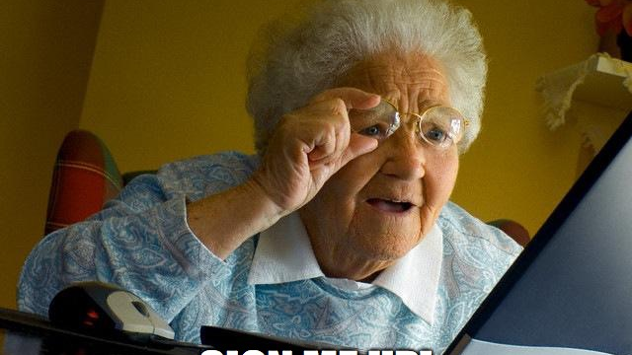

Slide 47
